Slide 1
Chapter 9 Understanding Laptops

Slide 2
Portable systems have gotten smaller, lighter (more portable), more powerful, and less expensive.
Because the technology and price disparity between the desktop and laptop platforms has decreased significantly, laptops have outsold desktops since the mid-2000s.
A portable computer is any computer that contains all of the functionality of a desktop computer system but is portable.

Slide 3
Of course laptops are not the only types of portable computers in the market today. There are Chromebooks, tablets, and a variety of handheld smartphones that can also lay claim to being called computers.
The original portable computers were hardly portable, hence the unofficial term luggable. They were highly inferior to desktops and very expensive
https://www.youtube.com/watch?v=DSOq-VvIPqs
Laptops are also called Notebooks because they resemble large notebooks

Slide 4
Understanding Laptop Architecture
They contain many parts that perform similar functions as desktops do
Because laptops are significantly smaller than desktops, this raises the concern of heat, hence laptop parts are significantly smaller
Also, laptop parts are designed to consume less power and to shut themselves off when not being used (desktops have the latter feature too)
Laptops have grown smaller and smaller. In 2007 the first Netbook was introduced – Chromebook is an example

Slide 5
Laptops vs Desktops
Primary Differences:
Portability – They run on batteries and have wireless network cards so you can move around with them.
Cost - Their prices are much higher than desktops even though desktops are much more powerful because miniature versions of components cost more. But the price difference has shrunk significantly in the last few years

Slide 6
Laptops vs Desktops
Performance - Compromises must often be made between performance and portability, and considering that portability is the major feature of a laptop, performance is what usually suffers. Laptops that outperform desktops are significantly higher in cost
Expandability – Desktops are designed to be modular hence their capabilities are easier to upgrade. Other than memory and hard drives, most laptop upgrades consist of adding an external device through one of the laptop’s ports, such as a USB port – processors and motherboards are next to impossible to upgrade

Slide 7
Laptops vs Desktops
Quality of construction - materials used to construct the laptop case and other components must be extremely durable. Durability is important in a desktop too, but it won’t be tested as much as in a laptop.

Slide 8
Laptop Case
Made up of 3 main parts:
Display – LCD or LED
Case Frame – Metal reinforcing structure inside the laptop for rigidity
The case – plastic cover for protection against other elements
**In the A+ objectives, you will see the words plastics and frames used together. These terms are basically interchangeable with the term laptop case

Slide 9
Motherboards and Processors
Backbone structure / connects all components
All components are integrated

Slide 10
Motherboards
Their motherboards differ from desktops – 1. Smaller FF 2. Lack standards
Uniquely shaped to fit the specific case i.e. proprietary
Daughter board – saves space. Video circuitry, usb , network etc. can be built on a daughter board. Disadvantage – whole board needs to be replaced if a part goes bad

Slide 11
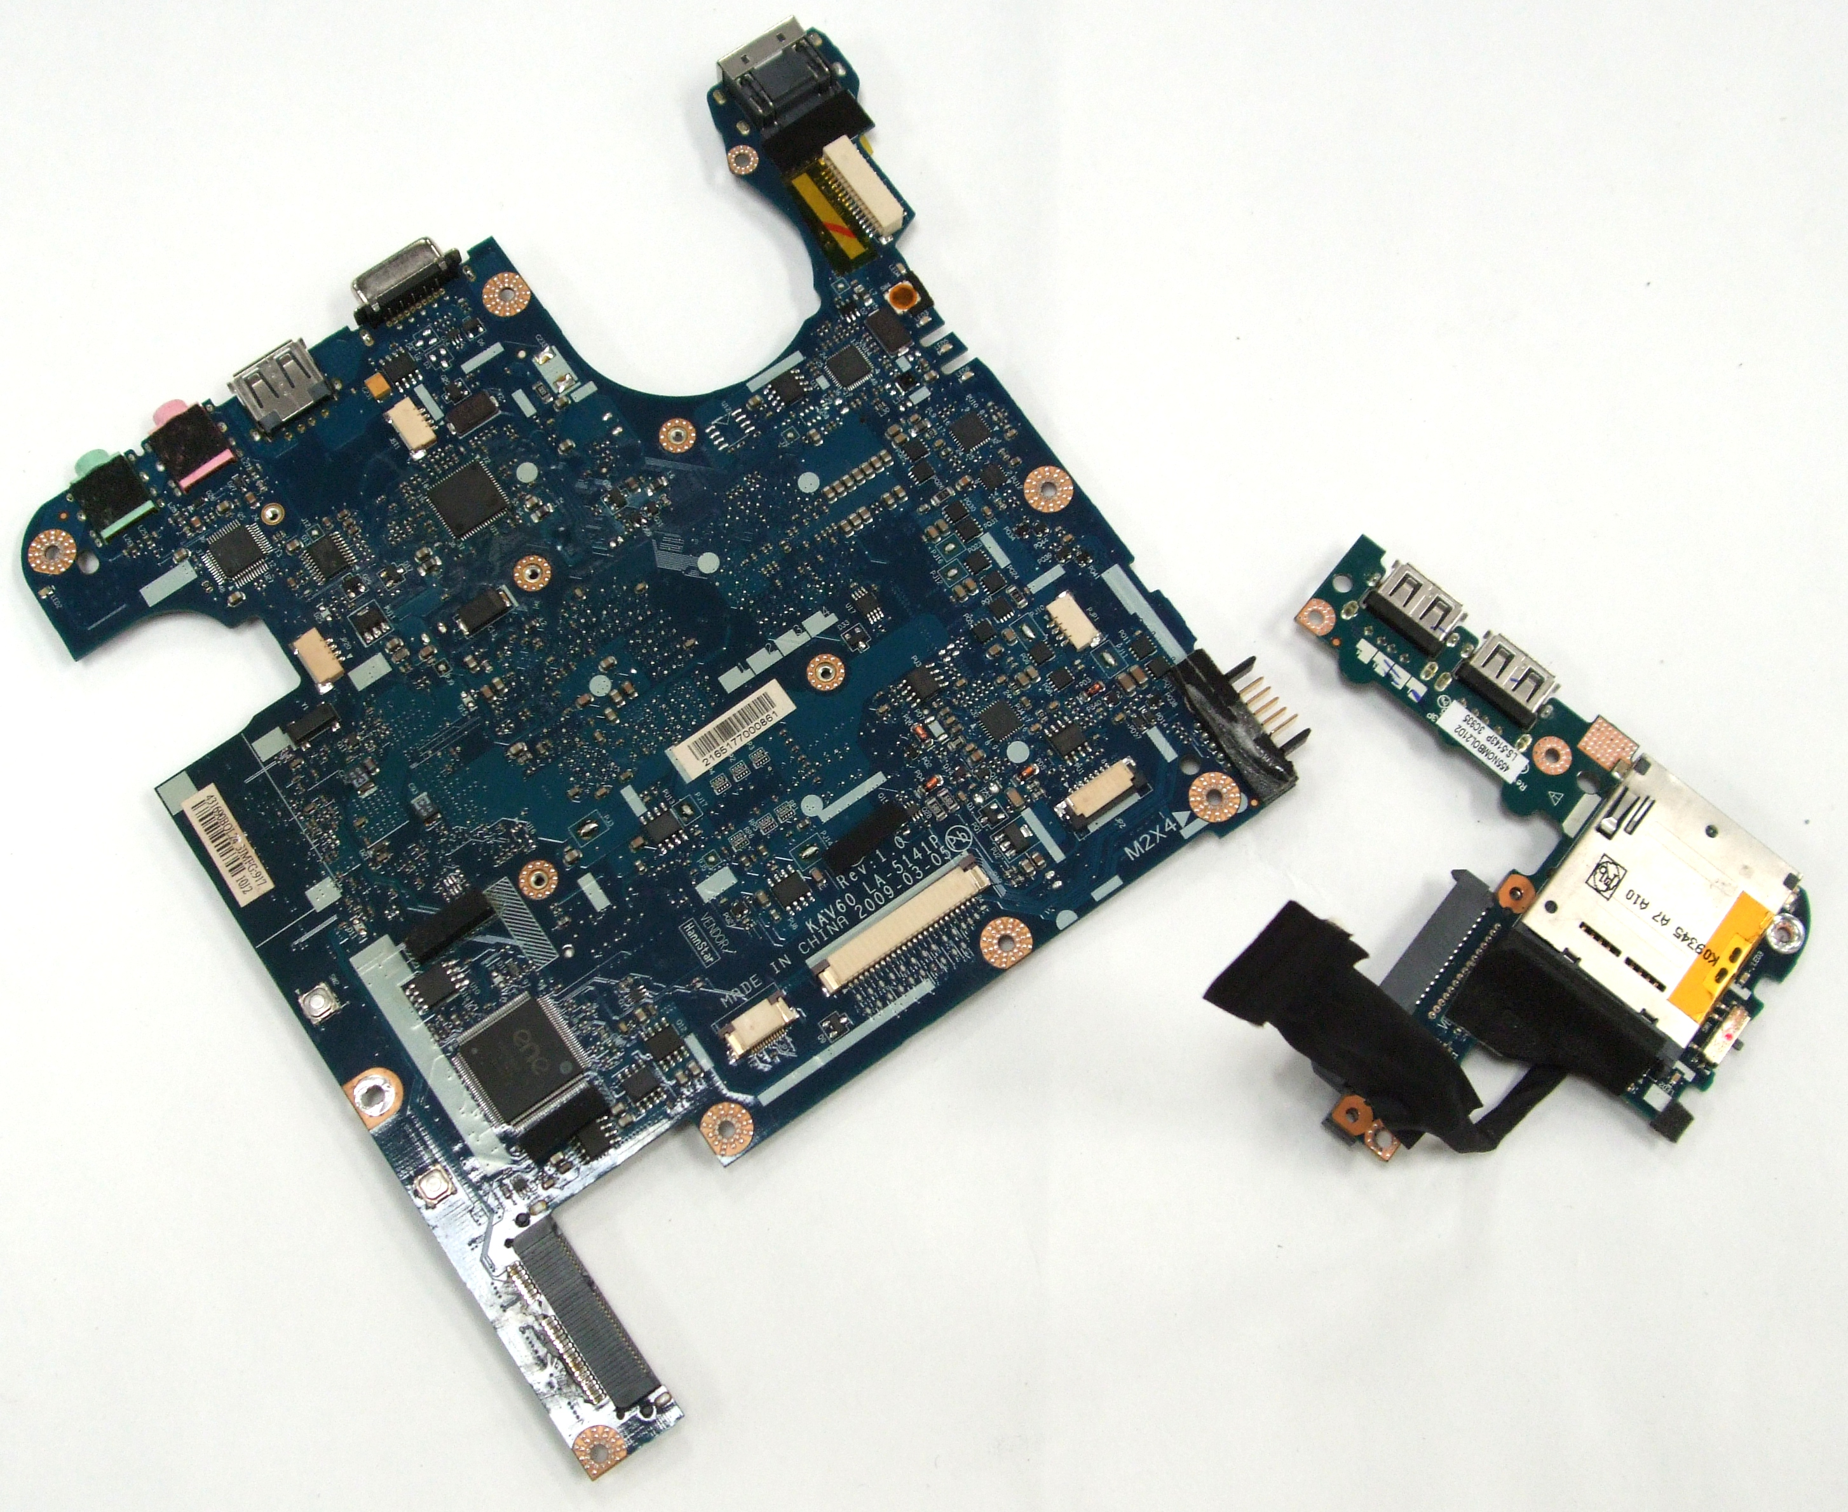
Daughterboard

Slide 12
Laptop processor
Brain of the laptop, smaller, slower
Small laptop case means heat issues, thus processors are built with:
Streamlined connection to the motherboard –soldered directly or built with Micro-FCBGA (Flip Chip Board Grid Array), i.e. balls instead of pins
Lower voltage/clock speeds – to combat heat processor voltage is lowered or speed reduced
Active sleep and slowdown modes – Processor throttling – run in lower power when on battery to extend battery life and throttled back up when power is available

Slide 13
Laptop processor
Many laptop processors include built in wireless networking
E.g. Pentium M consist of
Graphics memory controller chipset
Intel Pro Wireless LAN connection
Intel Centrino chipset (the brain) which runs at lower power than Desktop processors

Slide 14
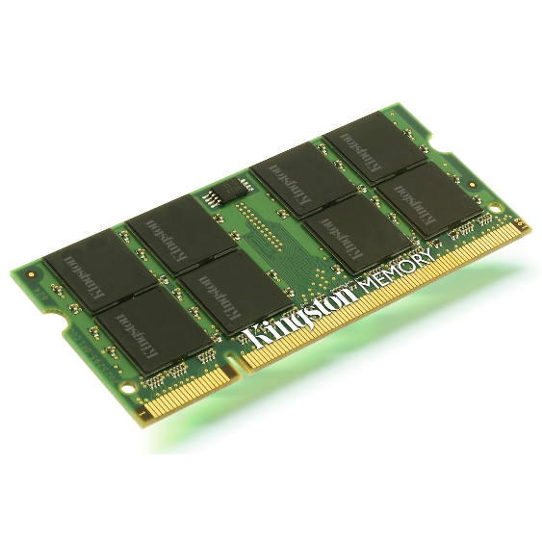
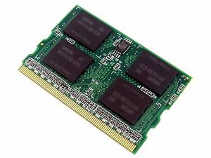
Memory
2 Types – SODIMM (small outline) and MicroDimm (50% smaller)

Slide 15
Memory Recap: Physical Differences between DDR, DDR2 and DDR3
DDR | DDR2 | DDR3
1st Generation | 2nd Generation | 3rd Generation
Chips use TSOP (Thin Small Outline package) – square chip with legs on left and right | Chips are mounted using Ball Grid Array – invisible ball-like legs under the chip directly plug to the board | Ball Grid Array
Notch is slightly to the right | Notch is a little more to the middle | Notch is further to the left
Long rectangular chips | Square chips | Small square chips

Slide 16
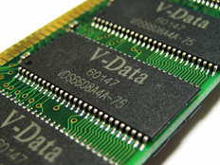
DDR 1 Thin Small Outline Package (Surface Mounted)

Slide 17
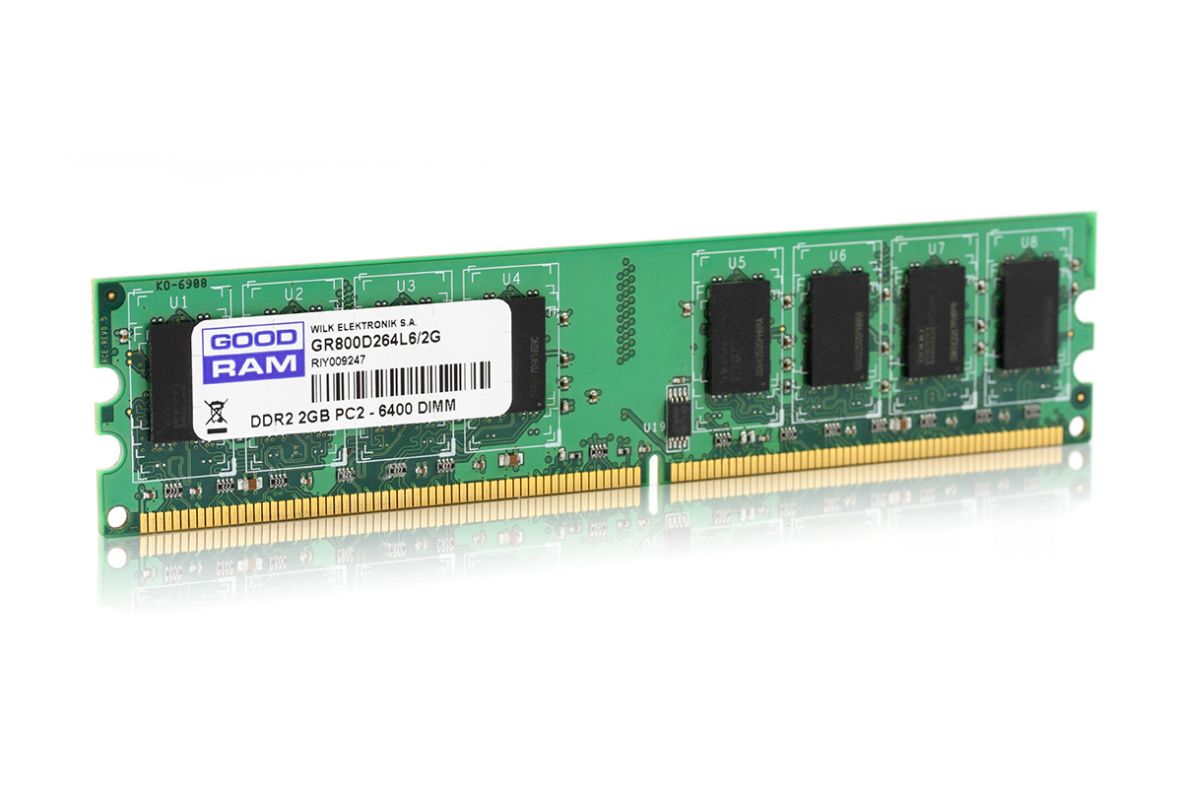
Ball Grid Array

Slide 18
Memory
SODIMM
Smaller than DIMMS. Available in DDR, DDR2 and DDR3
32-bit (72-pin) and 64-bit (144-pin SDRAM, 200-pin DDR, 200-pin DDR2, and 204-pin DDR3) configuration available
MicroDIMM
Newer. 50% smaller than SODIMM
Does not have any notches on the bottom
64-bit modules with 172 or 214 pins for DDR2 are popular

Slide 19
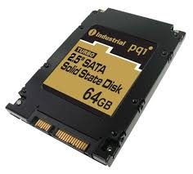
Storage – Trend moving to cloud based storage
Hard drives – 2.5” or 1.8” instead of the fullsized 3.5”
SSD – no moving parts, similar
PATA/SATA connections, faster, less
Power, silent, harder to damage, more
Reliable but EXPENSIVE, smaller space
SSD
Desktop HDD
Laptop HDD

Slide 20
Hybrid drives – fusion of SSD and regular HDD drives. Frequently used files are stored on flash memory, others on magnetic plates. Price/performance in between HDD and SSD
Optical drives – smaller but similar functionality. More expensive

Slide 21
Input Devices
Keyboard – built into the lower portion of the clamshell. Special function keys (Fn) combinations commonly control video, audio and media, network)
**Numeric pad is normally missing.
**Video dimming and source selection

Slide 22
Input Devices
Pointing devices
Trackball - similar to a mouse turned upside down. Pick up durst and therefore do not last
Touchpad - has a pad of touch-sensitive material. Touch sensitive
Pointing stick - a pointing device that uses a small rubber-tipped stick – in between the GB&H keys on Lenovo and IBM laptops
Touchscreen – Screen senses touch. How they work beyond the scope

Slide 23
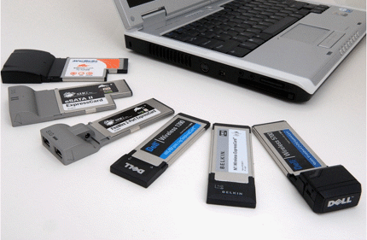
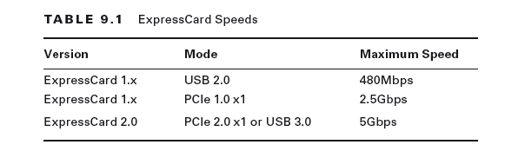
Expansion Buses and Ports
Express Cards - support USB 2.0, USB 3.0, and PCI Express

Slide 24
Expansion Buses and Ports
Mini-PCIe – replaces Mini-PCI and reside inside the case

Slide 25
Expansion Buses and Ports
USB Ports for expansion
USB devices that act as adaptors include:
■■ USB to RJ-45 ■■ USB to Wi-Fi
■■ USB to Bluetooth ■■ USB to HDMI
■■ USB to Thunderbolt ■■ USB to DisplayPort
■■ USB optical drives ■■ USB smart card readers

Slide 27
DisplayPort
Video Electronics Standards Association (VESA) introduced DisplayPort in 2008.
Was to replace VGA and DVI, Backward compatible using adapters

Slide 28
Thunderbolt
Launched by Apple in 2011
Includes support for PCIe
Thunderbolt supports not only video devices but also several other types of peripherals – HDD, SSD, Printers, docking stations etc

Slide 29
Other Ports
Mouse/Keyboard Port – PS2 and USB
Communications Port – wireless cards standard, others have modem, Bluetooth, infrared, cellular and ethernet

Slide 30
Docking station
Docking Port - used to connect the laptop
Docking station - an extension of the motherboard of a laptop

Slide 31
Docking stations
A port replicator reproduces the functions of the ports on the back of a laptop so that peripherals such as monitors, keyboards, printers, and so on that don’t travel with the laptop can remain connected to the dock and don’t all have to be unplugged physically each time the laptop is taken away.
Docking stations function as port replicators

Slide 32
Power Systems
Portable computers can use either of two power sources: batteries or adapted power from an AC or DC source
AC power source needs to be rectified (converted) to DC to power internal components

Slide 33
Batteries
Types of batteries (chemistrie):
Nickel cadmium (NiCd),
lithium-ion (Li-ion), and
nickel-metal hydride (NiMH)
lithium-polymer (Li-poly)

Slide 34
Energy density measures how much energy a battery can hold.
Power density measures how quickly the stored energy can be accessed,

Slide 35
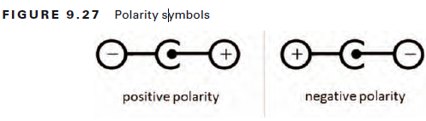
Power adapters
Convert AC to DC

Slide 36
Laptop Displays
Video Card
Like desktops it’s responsible for generating and managing the image sent to the screen
Most LCD monitors are digital, meaning that you need a video card that puts out a digital image

Slide 37
Backlight
LCD displays don’t produce light
The typical laptop display uses a cold cathode fluorescent lamp (CCFL) as its backlight

Slide 38
Inverter
Fluorescent backlight require high energy/voltage
The inverter is a small circuit board installed behind the LCD panel that takes DC current and inverts it to AC for the backlight
Causes flickers if faulty
Inverters can discharge energy, which can cause severe injury to you. Be careful when working with them!

Slide 39
Screen - Current popular options include LCD, LED, and OLED (ch4)
Digitizer is a device that can be written or drawn on, and the content will be converted from analog input to digital images on the computer.
Webcam and Microphone
Wi-Fi Antenna - generally run through the upper half of the clamshell case
Cable Locks – for security

Slide 40
Disassembling and Reassembling laptops
Be organized
Document
Use the right tools

